Slide 1

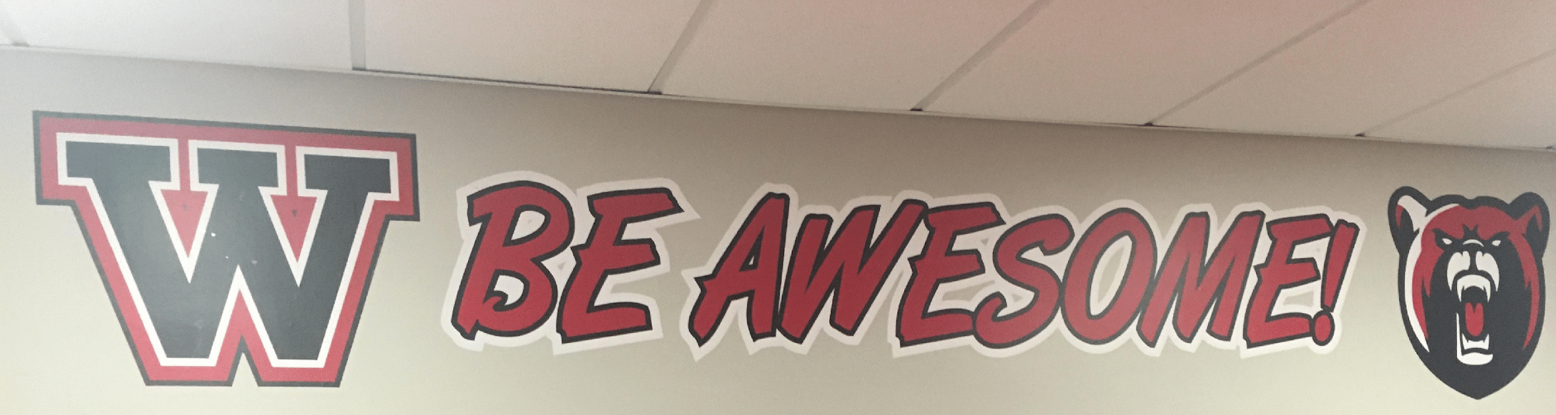
©
Middle School West
New Student Orientation
August 20, 2025

Slide 2
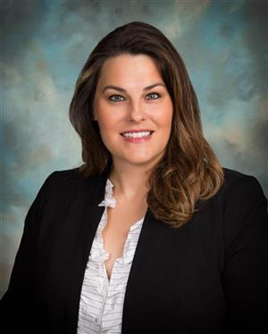
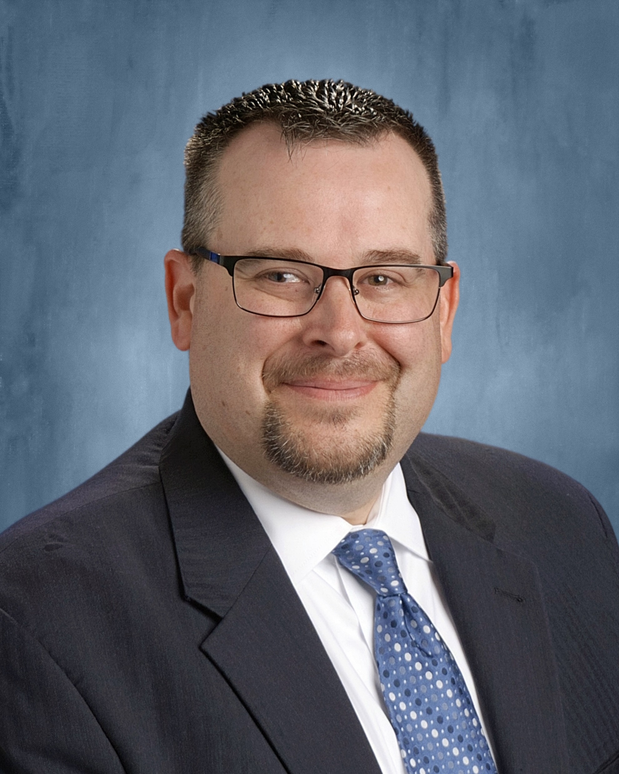
Administrative Team
©
Mrs. Dombrowski
Principal
Mr. Schmaldienst
Assistant Principal

Slide 3
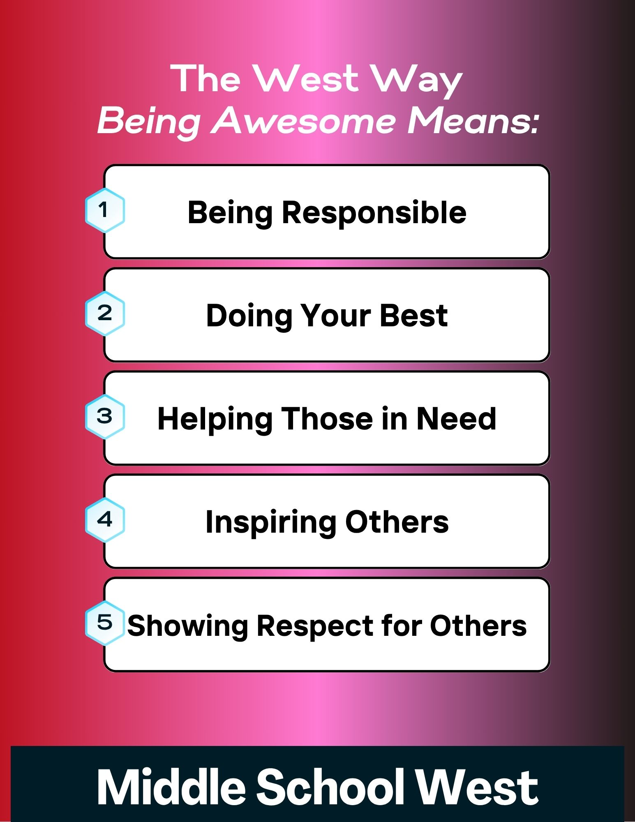

Slide 4
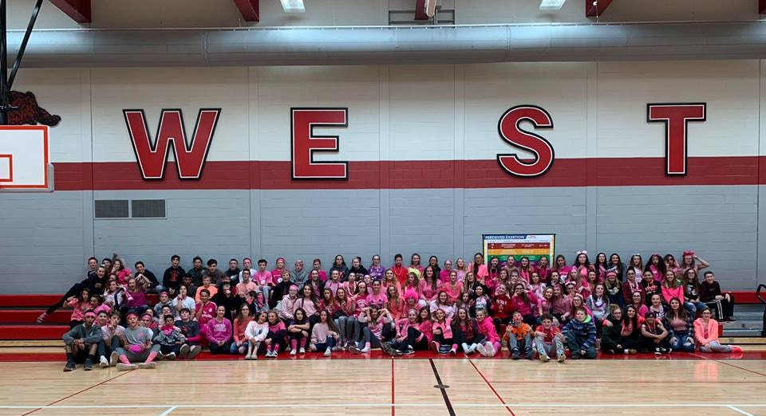
Tonight’s Agenda
©
Introductions
General Information
Upcoming Events
Answer any Questions
Find your Locker

Slide 5
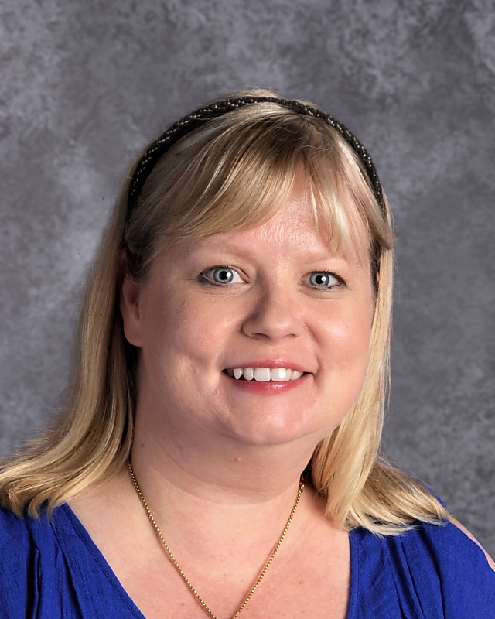
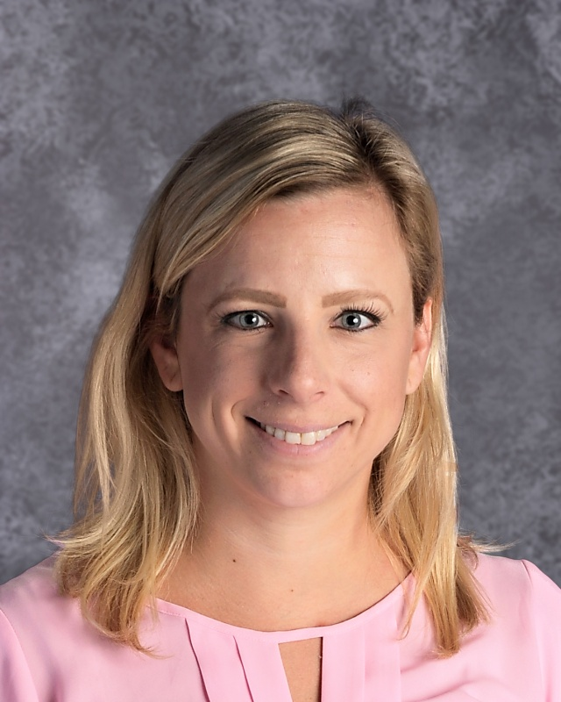
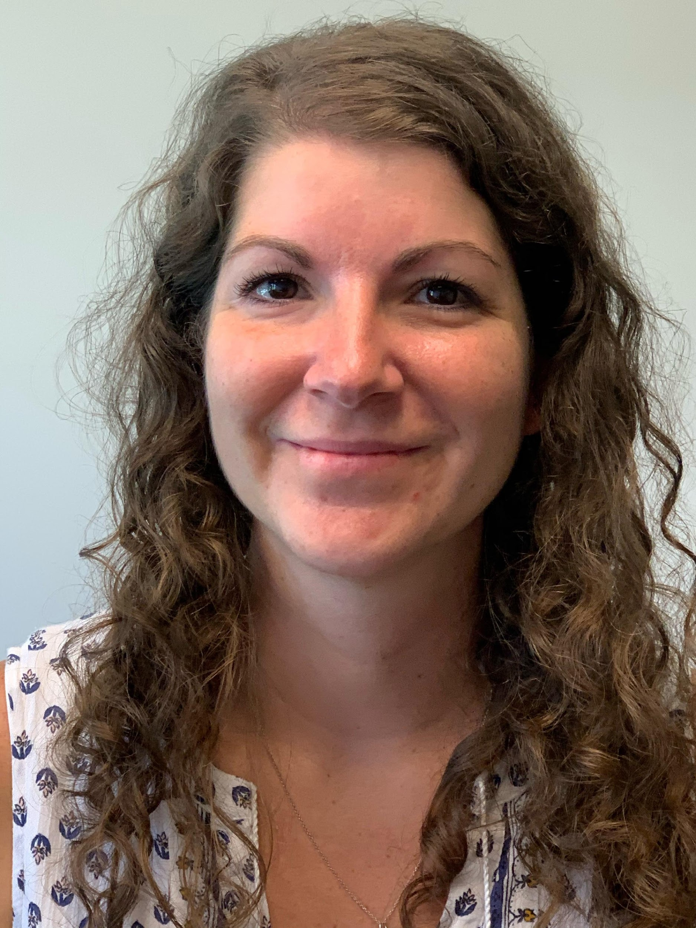
School Counselors
©
Mrs. Turnbull
Grade 6
Mrs. Jones
Grade 7
Mrs. Tyler
Grade 8

Slide 6
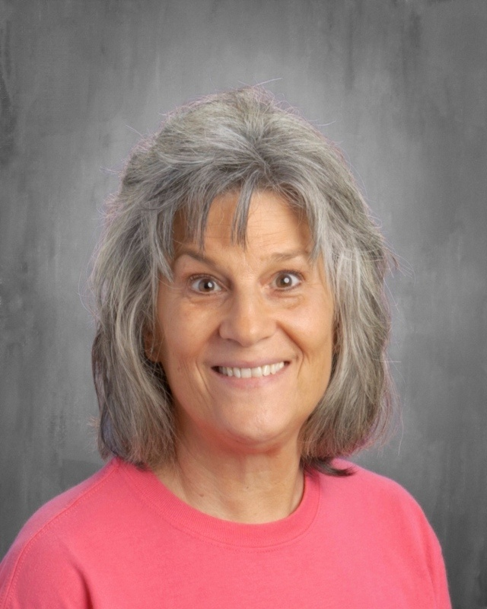
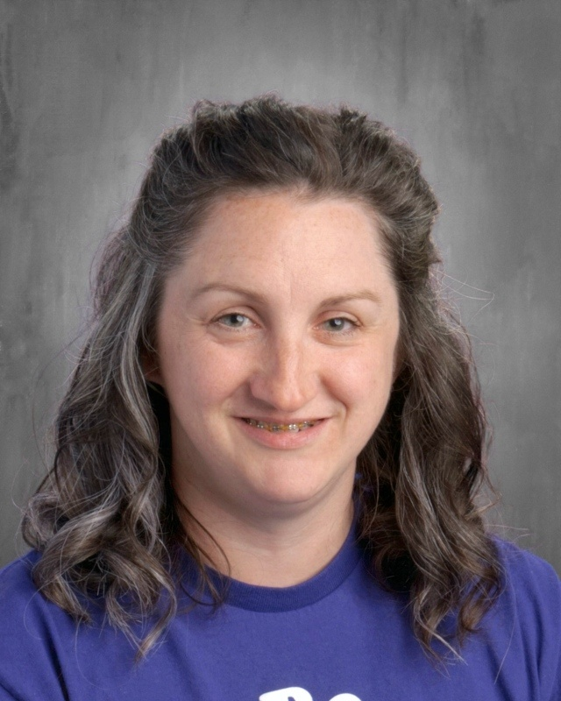
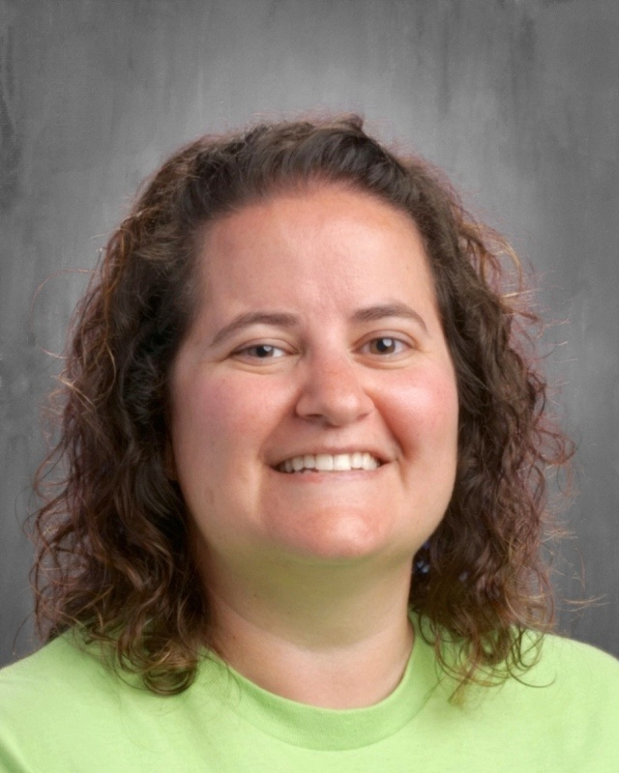
Secretaries
©
Mrs. Benfield
Secretary
Mrs. Algeo
Secretary
Mrs. McDowell
Attendance/ISS

Slide 7
6th Grade Faculty
©
Loyalty
  Ms. Dierolf – ELA & Social Studies
  Ms. Mauser – Math
  Mr. McAuliffe – ELA
  Ms. Reinhart – Science
  Ms. Roth – Math
Integrity
  Mr. Ferster – ELA
  Ms. Gallie – ELA
  Mr. Hazel – Science & Math
  Ms. Shelly – Social Studies
  Ms. Wentzel -- Math

Slide 8
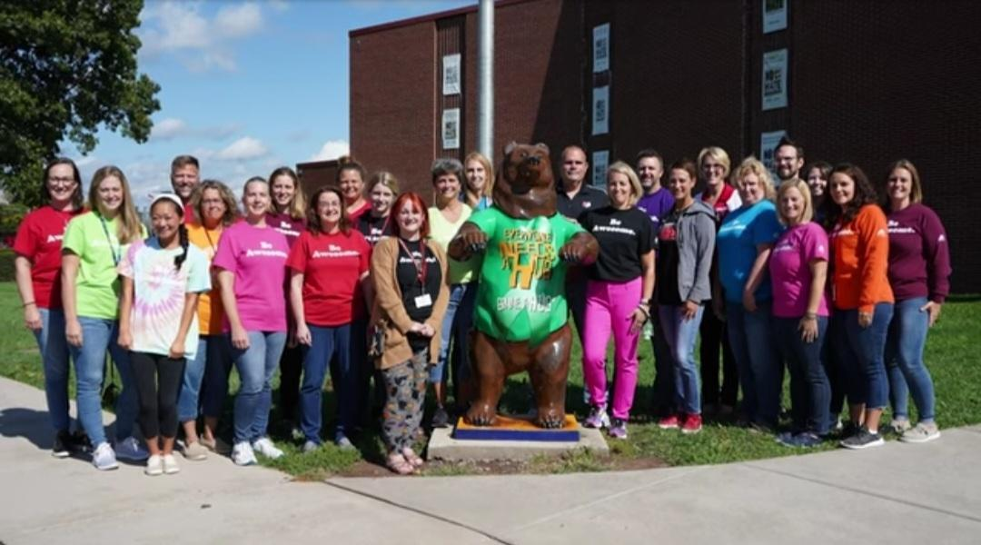
6th Grade Faculty
©
Special Education
  Ms. Quay
  Ms. Witman

Slide 9
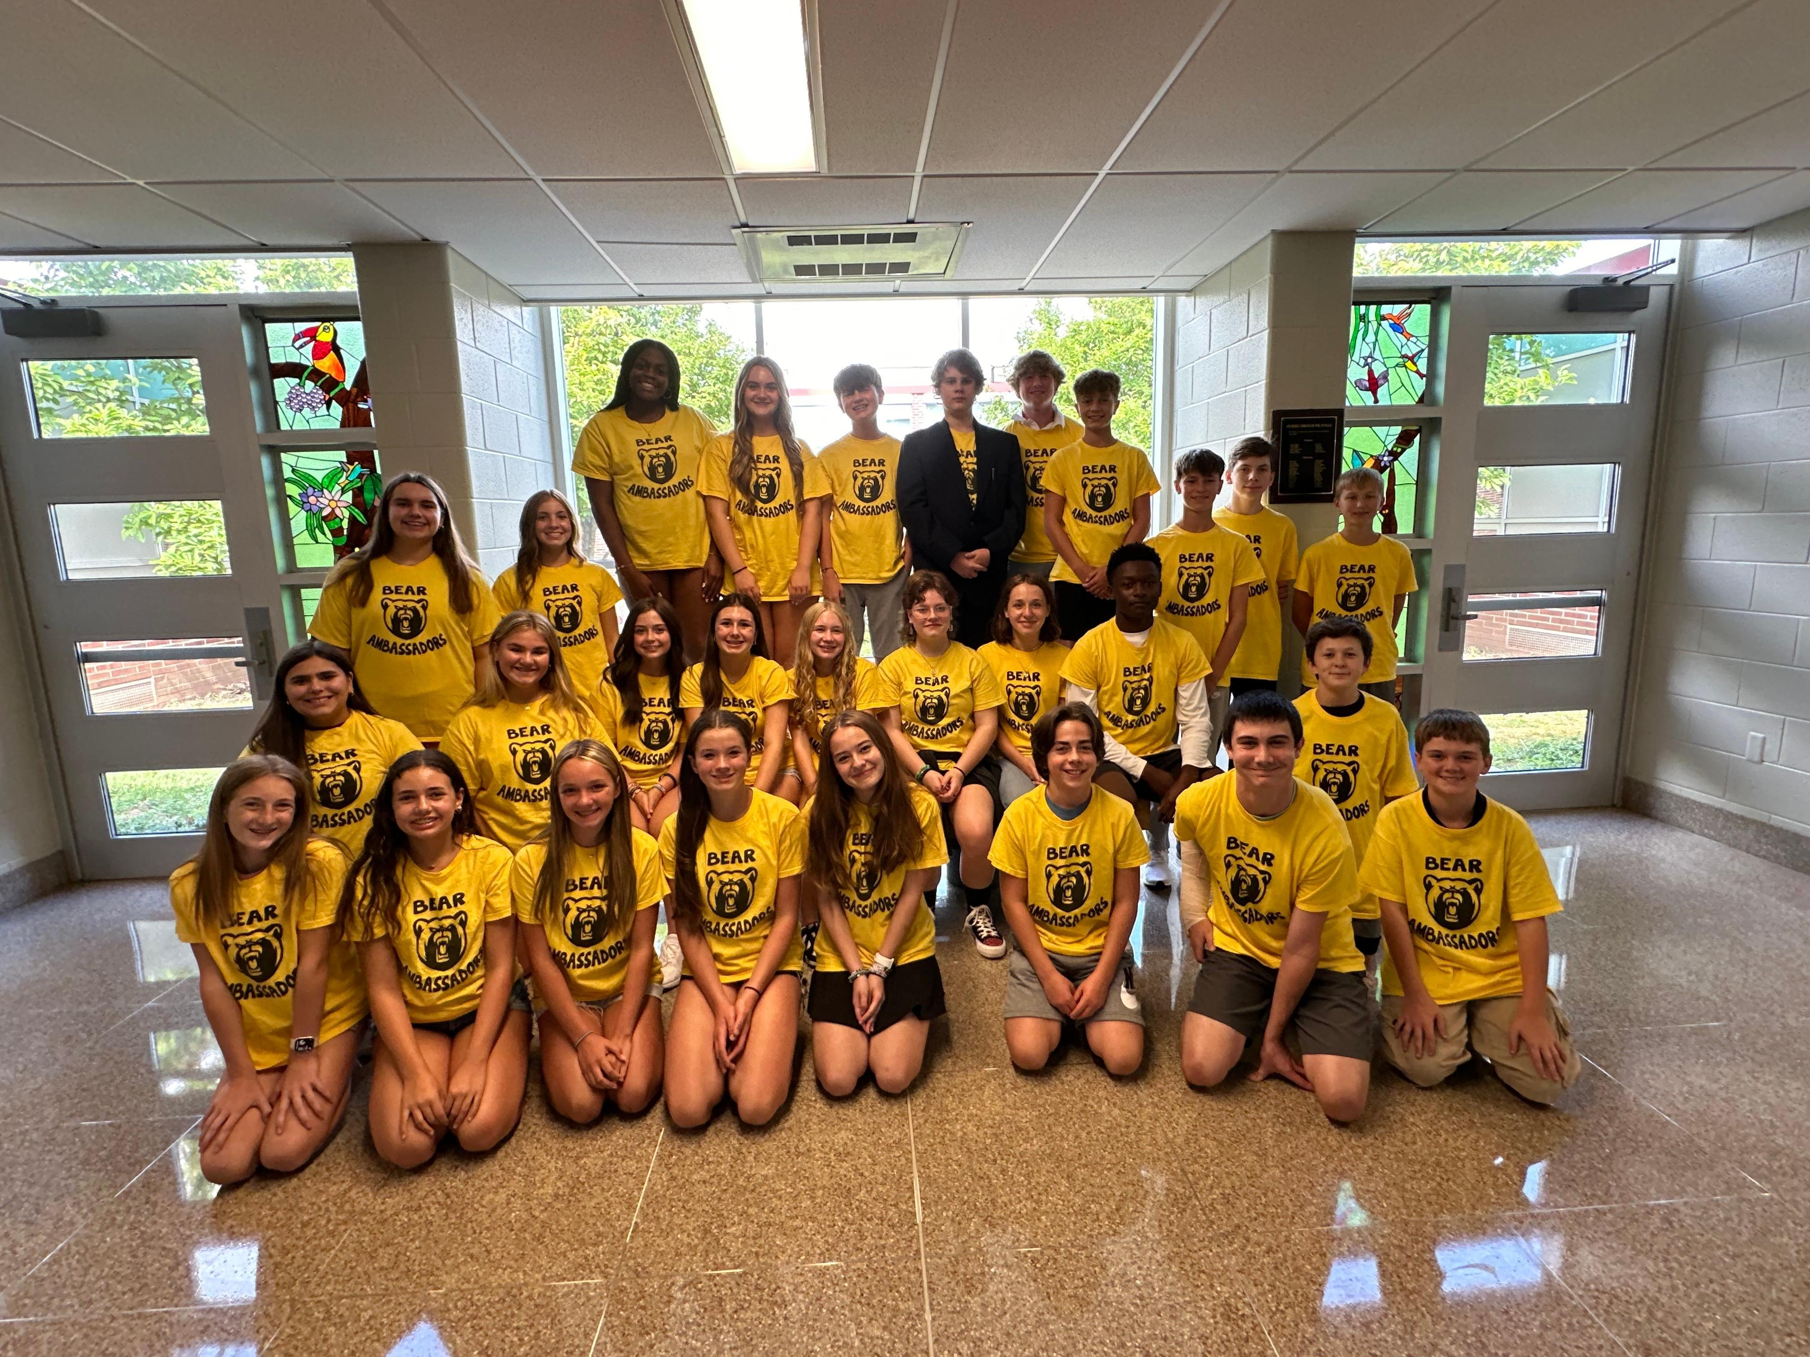
Meet the Bear Ambassadors!
©
What is a Bear Ambassador?
  8th grade leaders.
  Mentors for 6th grade students.
  Assist with team building and other activities throughout the year.
  Assist students in hallways during the first few days of school.
  Provide a connection to our school for new students that enroll during the school year.

Slide 10
Daily Schedule
©
Period | Time
Doors Open* | 7:15AM
Hallway Bell | 7:25AM
Warning Bell | 7:33AM
Homeroom Bell | 7:35AM
Homeroom | 7:35AM-7:42AM
Period 1 | 7:42AM-8:21AM
Period 2 | 8:24AM-9:03AM
Period 3 | 9:06AM-9:45AM
Period 4 | 9:48AM-10:27AM
Period 5 | 10:30AM-11:00AM Lunch
Period 6 | 11:03AM-11:42AM
Period 7 | 11:45AM-12:24PM
Period 8 | 12:27PM-1:06PM
Period 9 | 1:09PM-1:48PM
Period 10 | 1:51PM-2:35PM
Bus Dismissal | 2:35PM
Walker Dismissal | 2:35PM
Parent Pick Up | 2:35PM
*Students arriving prior to 7:25AM will report directly to the auditorium. Students eating breakfast will report directly to the cafeteria.

Slide 11
Daily Schedule
©
Sample Student Schedule
 | Day 1 | Day 2 | Day 3 | Day 4 | Day 5 | Day 6
1 | MATH | MATH | MATH | MATH | MATH | MATH
2
3 | ENGLISH LANGUAGE ARTS (ELA) | ENGLISH LANGUAGE ARTS (ELA) | ENGLISH LANGUAGE ARTS (ELA) | ENGLISH LANGUAGE ARTS (ELA) | ENGLISH LANGUAGE ARTS (ELA) | ENGLISH LANGUAGE ARTS (ELA)
4
5 | LUNCH | LUNCH | LUNCH | LUNCH | LUNCH | LUNCH
6 | SOCIAL STUDIES OR SCIENCE | SOCIAL STUDIES OR SCIENCE | SOCIAL STUDIES OR SCIENCE | SOCIAL STUDIES OR SCIENCE | SOCIAL STUDIES OR SCIENCE | SOCIAL STUDIES OR SCIENCE
7
8 | BUSINESS, ART, TECH. ED., HEALTH | BUSINESS, ART, TECH. ED., HEALTH | BUSINESS, ART, TECH. ED., HEALTH | BUSINESS, ART, TECH. ED., HEALTH | BUSINESS, ART, TECH. ED., HEALTH | BUSINESS, ART, TECH. ED., HEALTH
9 | PHYS. ED. | MUSIC/CHORUS | PHYS. ED. | MUSIC/CHORUS | PHYS. ED. | REACH FOR THE FUTURE
10 | CLUBS, INTERVENTIONS, PERFORMING GROUPS, STUDY HALL | CLUBS, INTERVENTIONS, PERFORMING GROUPS, STUDY HALL | CLUBS, INTERVENTIONS, PERFORMING GROUPS, STUDY HALL | CLUBS, INTERVENTIONS, PERFORMING GROUPS, STUDY HALL | CLUBS, INTERVENTIONS, PERFORMING GROUPS, STUDY HALL | CLUBS, INTERVENTIONS, PERFORMING GROUPS, STUDY HALL

Slide 12
Daily Schedule
©
Math
English Language Arts (ELA)
Science or Social Studies
Lunch
Period 10
  Clubs, Remediation, Study Halls, Music Ensembles
Specials
  All Year
    Physical Education (3 Days a Cycle)
    Music/Chorus (2 Days a Cycle)
    REACH for the Future (1 Day a Cycle)
  60 Days (Consecutive)
    Art
    Technology Education
  30 Days (Consecutive)
    Business and Health

Slide 13
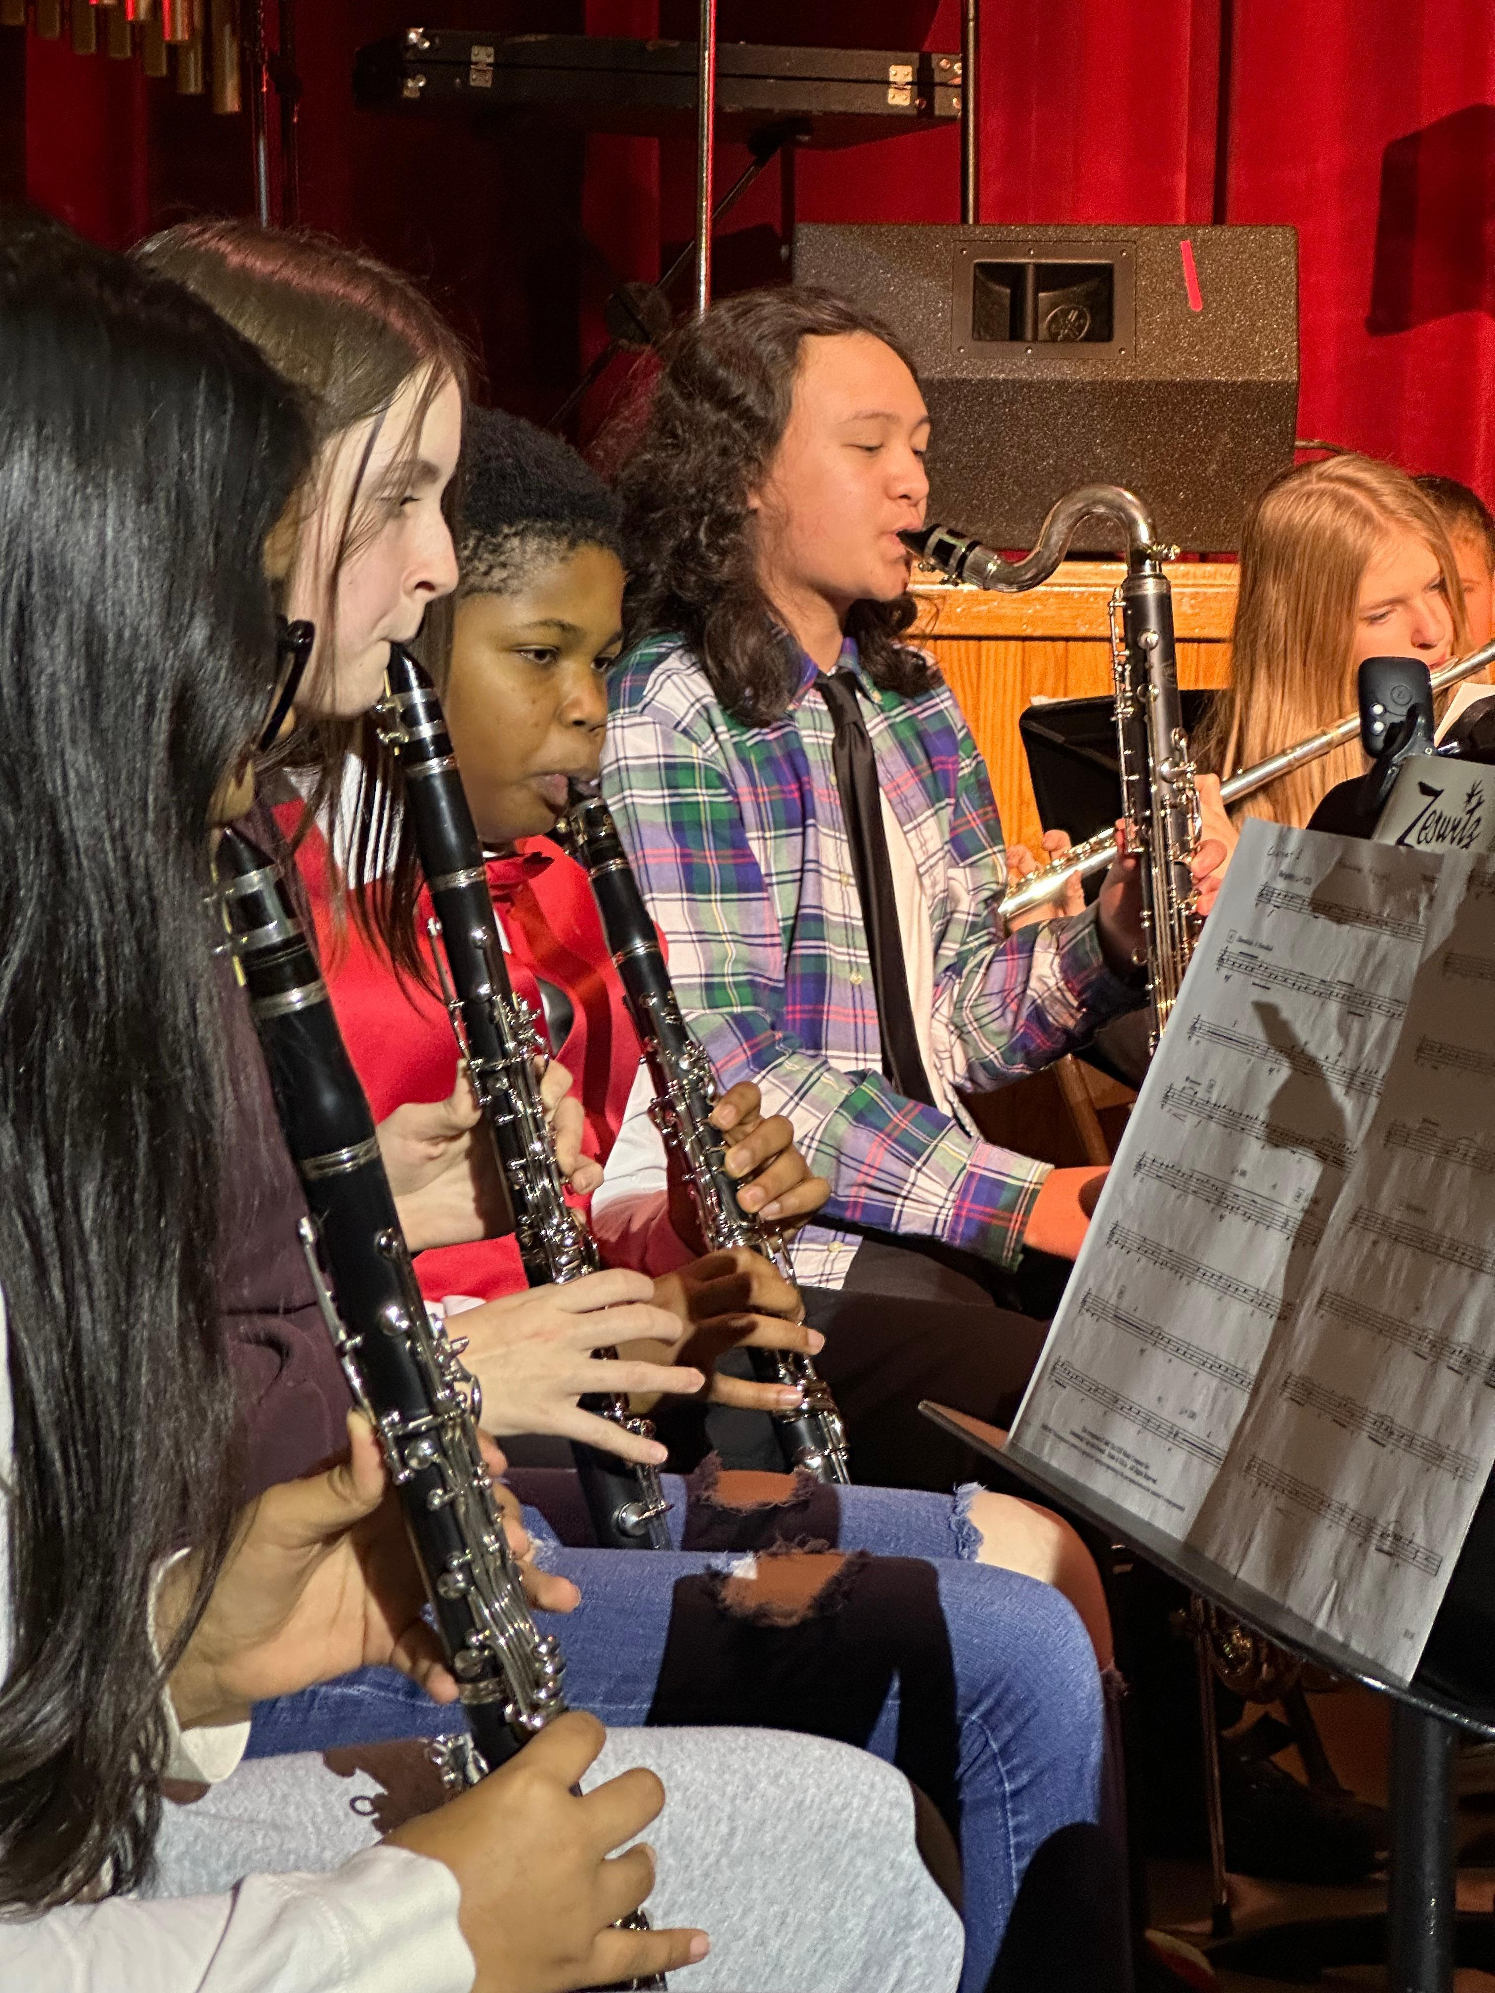
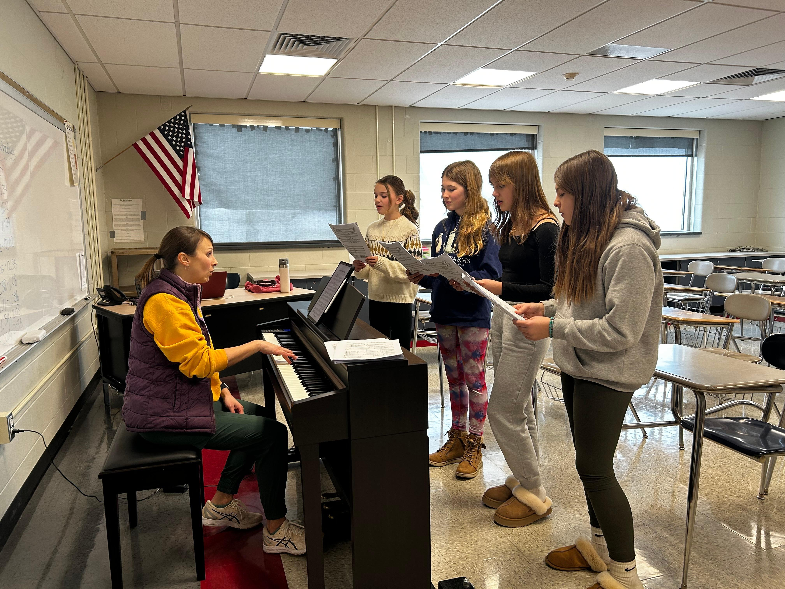
Period 10
©
Clubs
Study Hall
Enrichment/Remediation
Music Ensembles

Slide 14

REACH for the Future
©
What is REACH for the Future?
  Respectful
  Engaging
  Adaptable
  Creative
  Hopeful

Slide 15
REACH for the Future
©
Meets One Period Per Cycle – All year.
Focuses on:
  Anti-Bullying
  Suicide Awareness
  7 Habits for Highly Effective Teens
  Career Education & Work Standards
  Impact Skills

Slide 16

Assessment is Important
©
All assessment is important and helps guide our instruction.
      Classroom Assessments
      IXL
      PSSA
      Firefly
      If a student doesn’t take it seriously it may result in:
      Being placed in the wrong course.
      Being placed in interventions and/or camps
      when it isn’t needed.

Slide 17
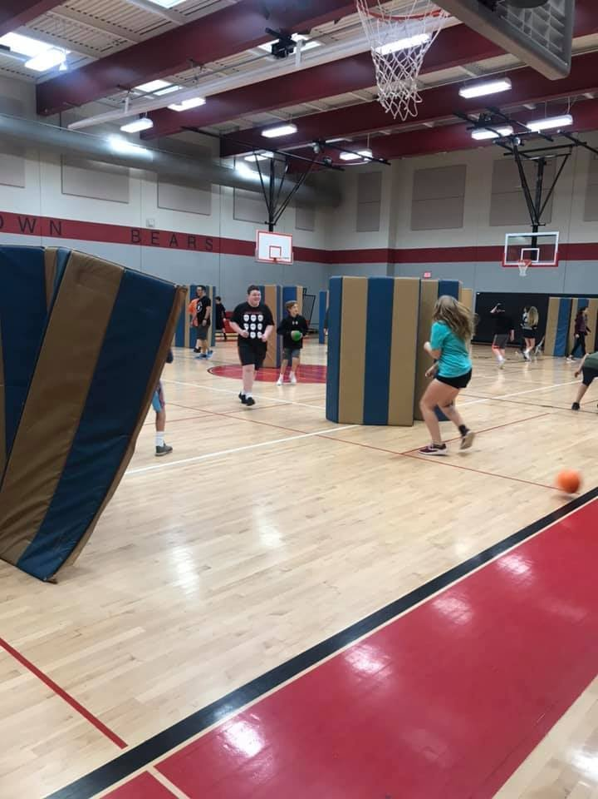
Physical Education
©
What should I wear?
  White, red, black or gray shorts and t-shirt.
  Athletic socks & sneakers.
  Consider having sweats for outside weather days.
What shouldn’t I wear?
  Cutoff/compression shorts, tank tops.
  Lettering on shirts that is not Boyertown related.

Slide 18
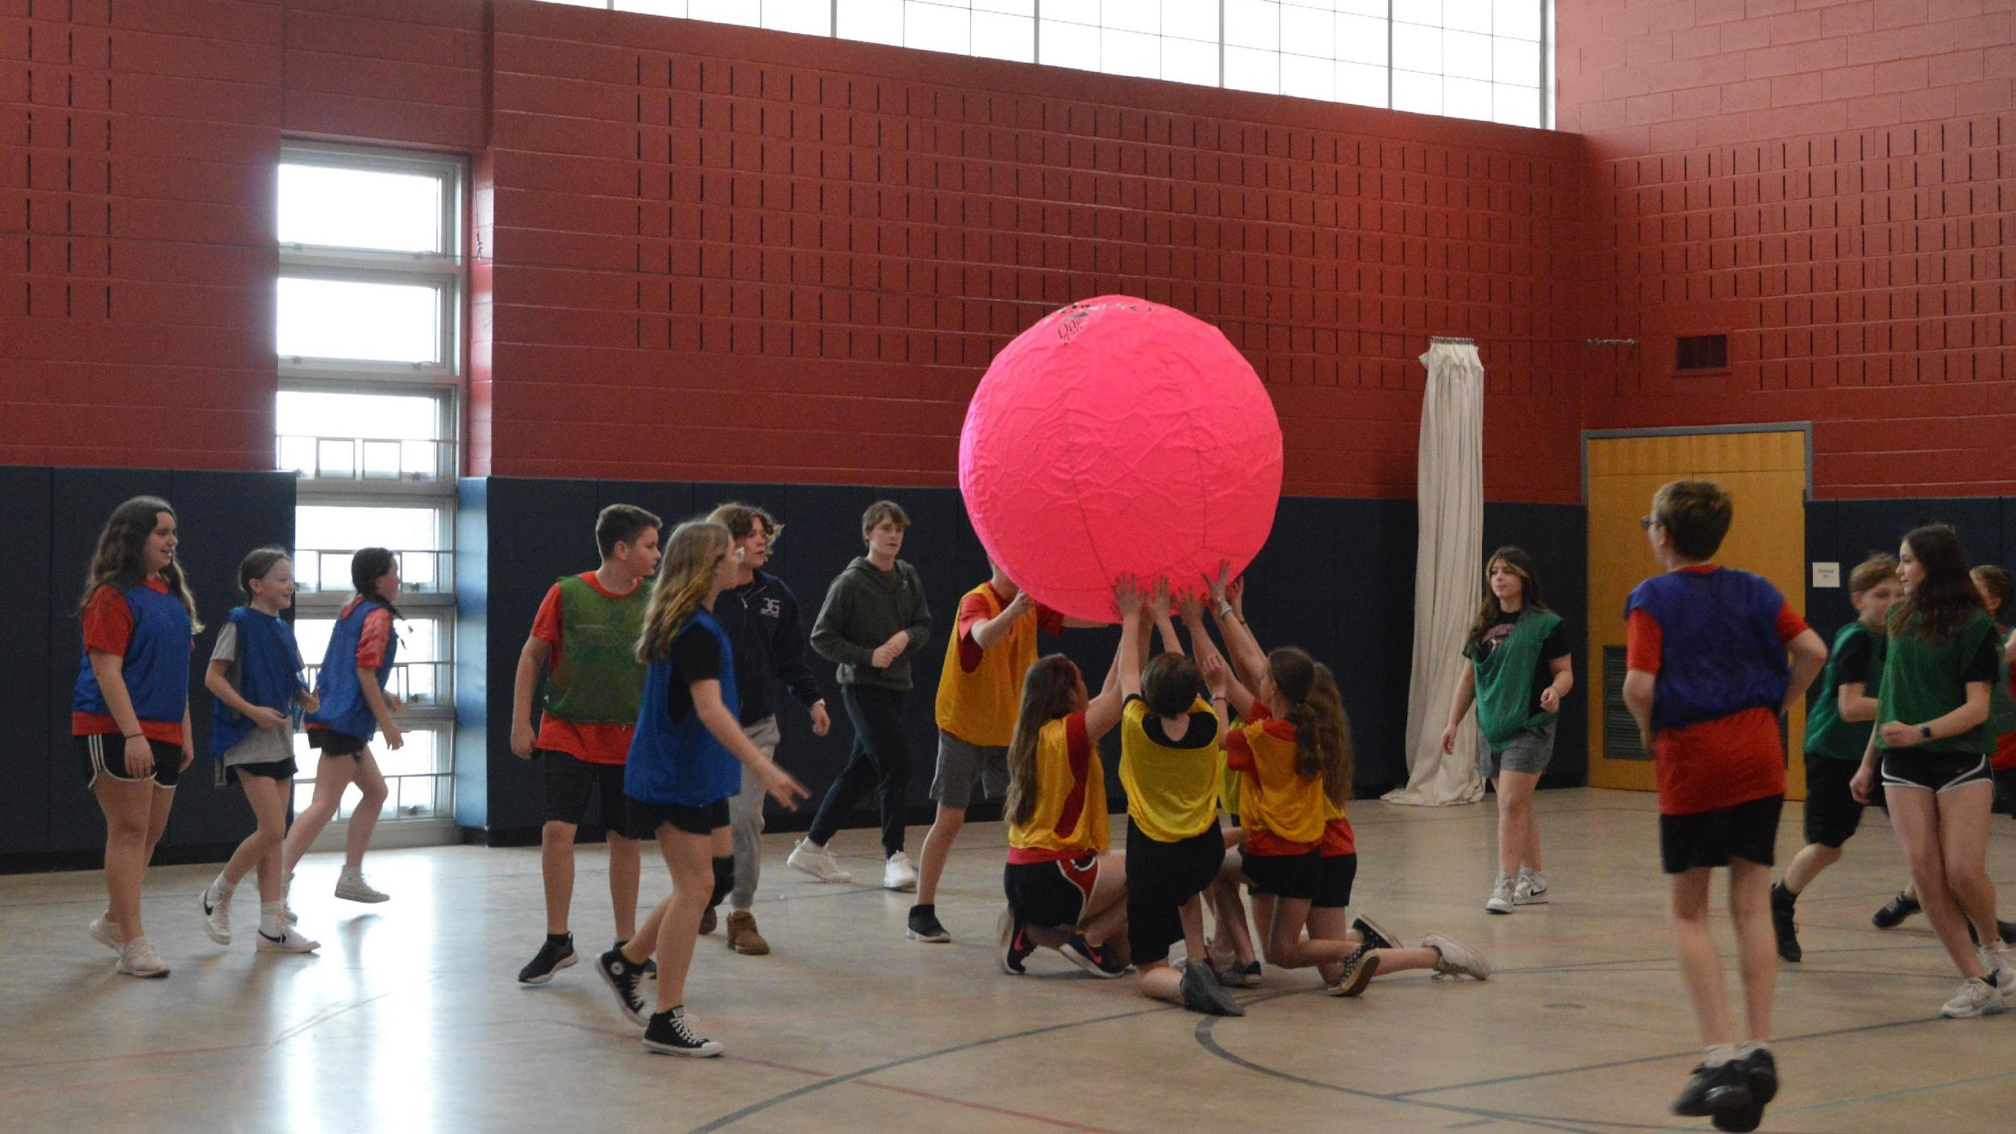
Physical Education
©
Students will be assigned a locker for Physical Education.
Students will NOT need to dress for PE on the first day. PE teachers will provide further details in class.

Slide 19
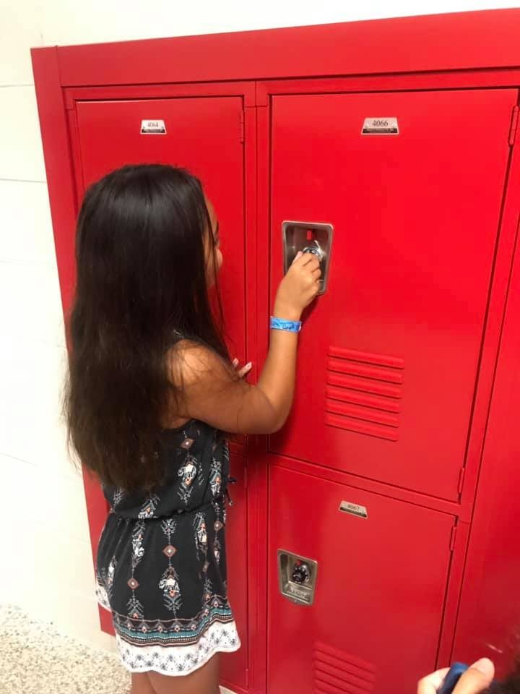
Lockers & Book Bags
©
Each student will have a locker assigned to them.
  You may access your locker at the following times:
    Beginning of the day
    Before/after lunch
    End of the day
  Do NOT share your combination with anyone!
Book bags may NOT be used during the school day.
  You may bring a backpack to school, but it must be stored in your locker during the day.

Slide 20

Communication
©
Infinite Campus
E-mail – Week in Review
School District Webpage
Coffee with the Principal

Slide 21

Safety
©
Emergency Drills
Secured Entrances
Raptor Visitor Verification System
Video Surveillance
Security Guard
Armed School Police Officer
Collaboration with Eastern Berks Regional PD

Slide 22
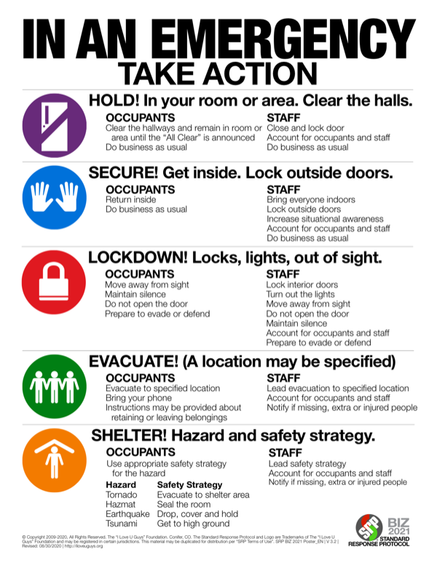
Safety
©

Slide 23
Safe2Say Something
©
Safe2Say Something is a youth violence prevention program run by the Pennsylvania Office of Attorney General. The program teaches youth and adults how to recognize warning signs and signals, especially within social media, from individuals who may be a threat to themselves or others and to “say something” BEFORE it is too late. With Safe2Say Something, it’s easy and confidential to report safety concerns to help prevent violence and tragedies.
www.safe2saypa.org

Slide 24

Technology
©
Students will receive a Chromebook.
Students are expected to take these devices home daily, charge them overnight, and bring them back each day.
Each student will be assessed an annual technology fee. Additional charges would be assessed for damage to the computer.
BASD Chromebooks should be used for academic use only.
BASD e-mail is monitored by a server bot to identify inappropriate/dangerous activity.
No stickers or signs on computers!
Do not stack items on your Chromebook!

Slide 25


Attendance
©
Attendance information for BASD is changing for the 2025-2026.
More information will be coming in the next few days.
There will be more integration between attendance and Infinite Campus.

Slide 26
Attendance
©
When a student is absent…
  A day will be marked as “unlawful if a note is not submitted within the 72-hour window.
  3 “unlawful” absences will result in a meeting being scheduled to create a “Student Attendance Improvement Plan” (SAIP).
  Referral to the Advancing Student Attendance Program (ASAP) may take place.
  6 “unlawful” absences will result in a citation for truancy being filed with the Magisterial District Justice (MDJ).

Slide 27

Cell Phones/Electronic Devices
©
Must be turned off and stored in your locker during the school day. This includes Smartwatches with data plans.
If a student needs to make a phone call during the school day for an emergency, permission may be given to call using the phone in room 16.
Parents/guardians should call the office if they need a message delivered to their child.
Students may not call/text to be picked up during the day. Only a nurse, counselor, or principal can send you home.

Slide 28
Cell Phones/Electronic Devices
©
Offense | Action Taken
1st | Confiscation & Warning
2nd | Confiscation & Warning
3rd | Confiscation & Parent/Guardian Pickup
4th and each additional occurrence | Confiscation, Parent/Guardian Pickup, and Lunch Detention
*Students who refuse to turn their phone over when requested will receive additional consequences.

Slide 29

Vaping
©
Vaping has become an increasing challenge in secondary schools.
Zero Tolerance
  3 days ISS
  Research project detailing dangers of vaping
  $50/$75/$100 fines by BASD – Increases per incident
  Citation with District Magistrate
All vape oil/juice will be tested for controlled substances
  $15 per test – 2 tests per incident – THC/Opioids

Slide 30

Important Items
©
Agenda Book
Student handbook/code of conduct
  Available Online
Dress Code – Online in the student handbook.
Food & Beverage
  Water only, with the exception of lunch.
  Water bottles can be refilled at the water bottle stations in the cafeteria or 30s hallway.
Toys and valuables should be left at home.

Slide 31
Parent Drop Off/Pick Up
©
Students will be allowed in the building at 7:15AM. Students arriving prior to 7:25AM will report to the auditorium (or cafeteria if purchasing breakfast).
Try to arrive early in the AM especially on bad weather days. Students must be in their homeroom seat by 7:35AM.
Drop off students will enter through door #17.
DO NOT PASS at drop off – Passing is permitted at dismissal.
Afternoon parent pickup begins at 2:35PM.
Please follow the plan – We need to keep everyone safe!

Slide 32
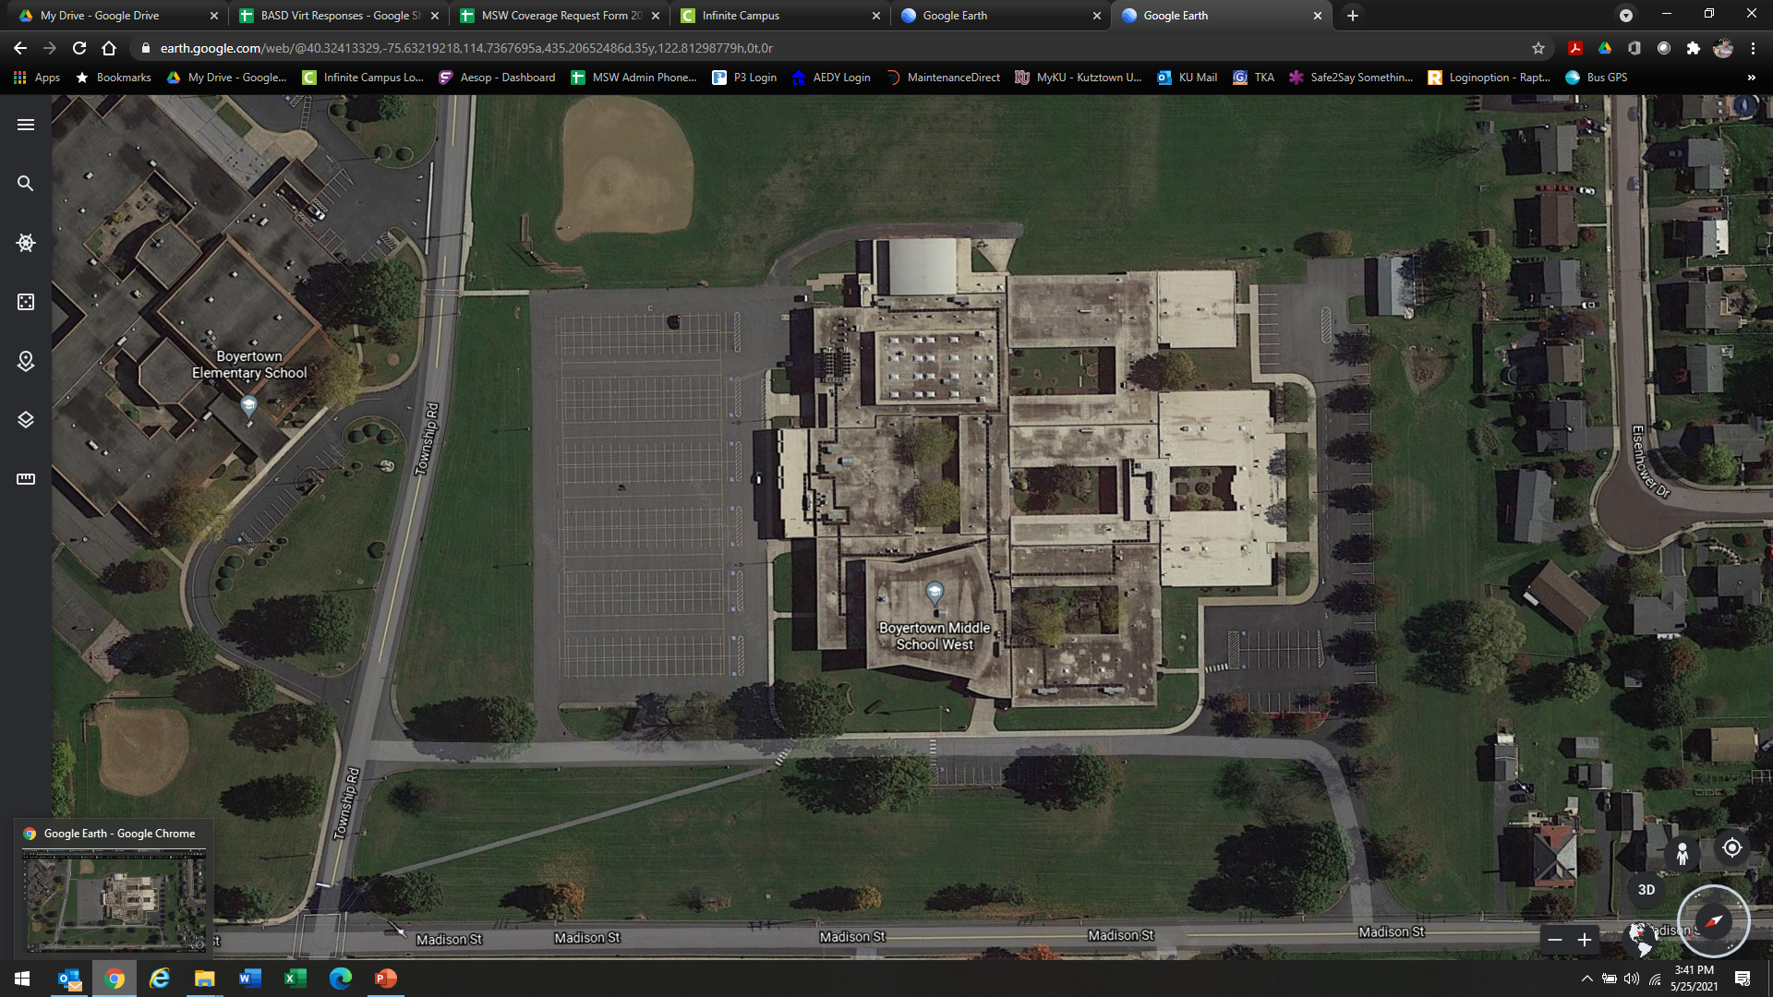
Middle School West
Dropoff & Pickup
SCHOOL BUS/VAN DROP OFF & PICK UP ONLY
Pick Up & Drop Off Here
Walker Entrance
Walker Exit
Pick Up & Drop Off Entrance & Exit

Slide 33

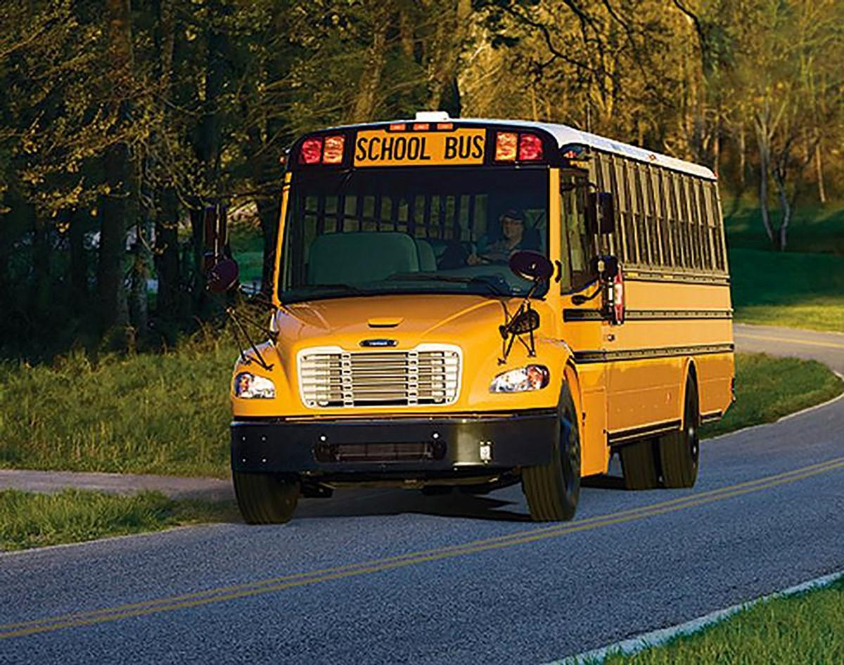
Bus & Walking Students
©
Walkers will enter the building through the side entrance by the faculty room (entrance #18) and will leave through the main entrance.
Stay off of people’s property. Remember many people have cameras on their homes now.
Bus students will be dropped off and picked up on the Boyertown Elementary side of the building.
Students arriving before 7:25AM will report directly to the auditorium or cafeteria (if purchasing breakfast).
Remember – There are multiple cameras on the buses!

Slide 34

Student Recognition Opportunities
©
Positive Notes (Mailed Home) – Over 800 sent home last year.
Be Awesome Awards
Student of the Month
End of Year Awards Ceremony

Slide 35
Upcoming Calendar
©
Date | Event
Monday, August 25, 2025 | First Day of School
Thursday, August 28, 2025 | Picture Day/Health Screenings
Friday, August 29, 2025 | Schools Closed
Monday, September 1, 2025 | Schools Closed
Friday, September 12, 2025 | Team Building Day (During School)
Wednesday, September 17, 2025 | Early Dismissal – No Lunch Served
Friday, October 10, 2025 | Student Council Dance
Monday, October 13, 2025 | Schools Closed – Professional Development
Wednesday, October 15, 2025 | Early Dismissal – No Lunch Served
Tuesday, November 11, 2025 | Schools Closed – Professional Development

